Slide 1
Report 04/07/2020
P. Hacker

Slide 2
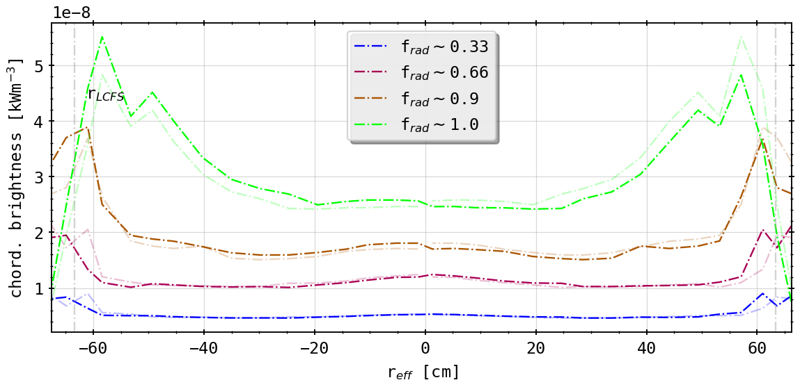
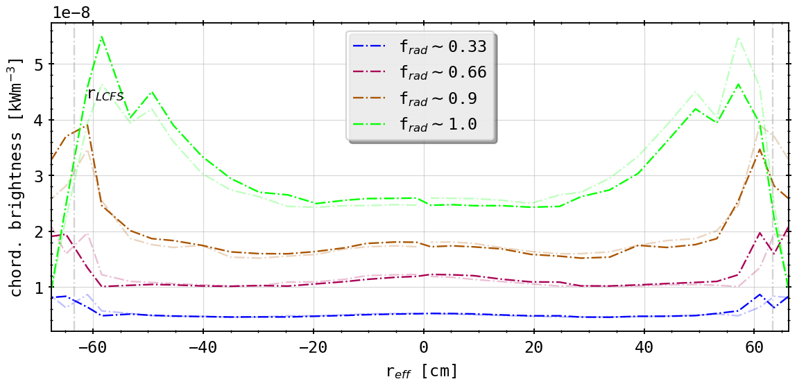
‘Standard’ Case vs. Planar Fix
(forward integration of STRAHL simulations)
(forward integration of STRAHL simulations with ‘fixed’ LoS)
virtually no changes?

Slide 3
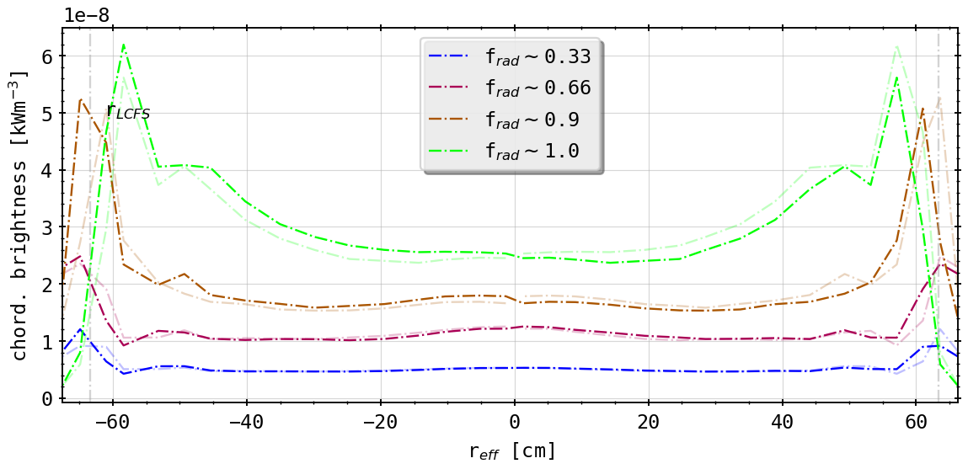
‘Standard’ Case vs. Toroidal Transformation
(forward integration of STRAHL simulations)
(geometry matrix in Bolometer plane at 108° with symmetric LoS orientation)
qualitatively small changes: SOL radiation zones now more peaked
radially no shift/difference in forward calculation
comparatively same level of asymmetry remains (fault in own calculation?)

Slide 4
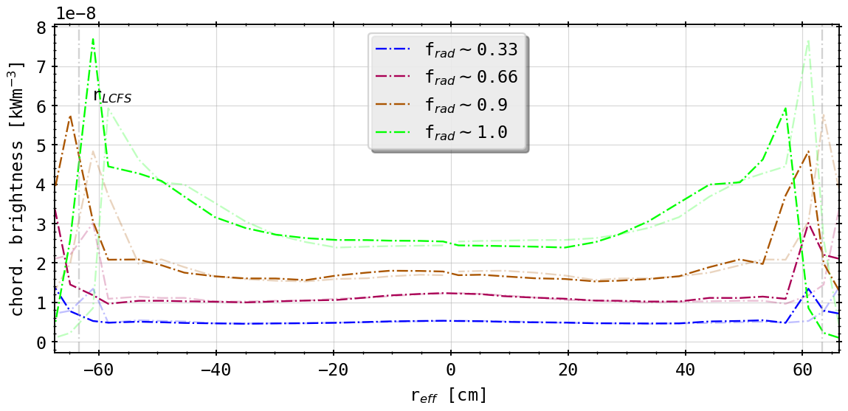
‘Standard’ Case vs. Toroidal Transformation and Tilt
(forward integration of STRAHL simulations)
(geometry matrix in Bolometer plane at 108° with symmetric LoS orientation and -1.0° tilt (up))
asymmetry becomes stronger
left hand side or brightness for ‘negative’ radii more peaked
alignment with fluxsurfaces better
also radial movement of radiation peaks further out (instead of inwards)

Slide 5
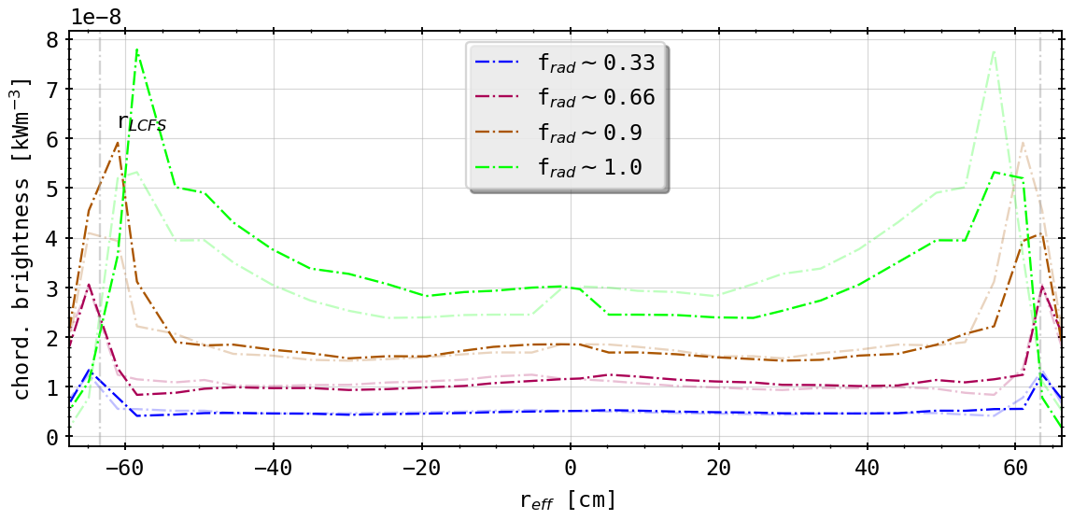
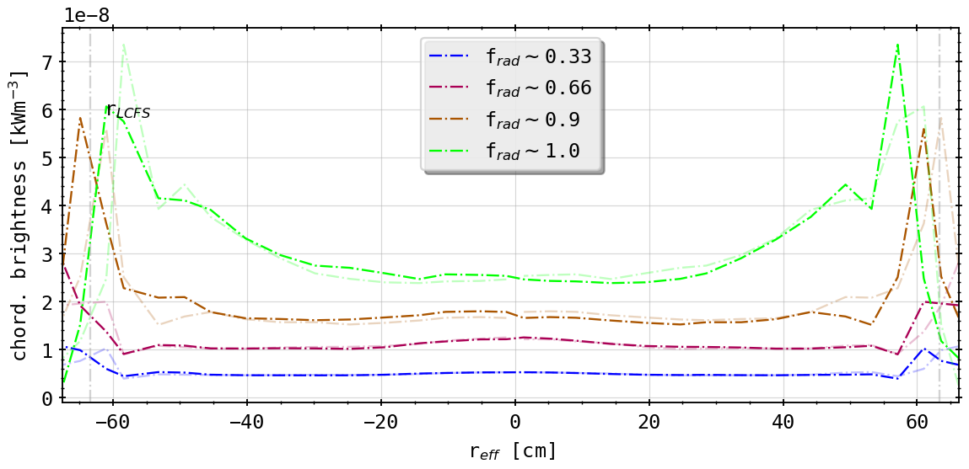
Different Tilts
(0.5° tilt (down))
(-0.5° tilt (up))
asymmetry switched around
alignment better now upside (tilt down!)
likewise radial movement as before!

Slide 6
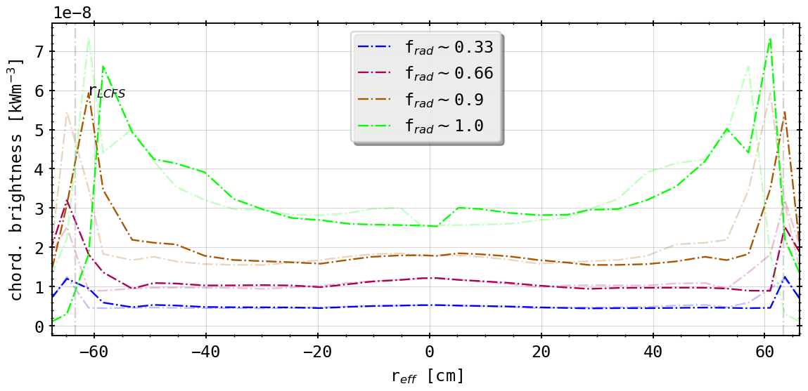
Different Tilts
(1.0° tilt (down))
(-1.0° tilt (up))

Slide 7
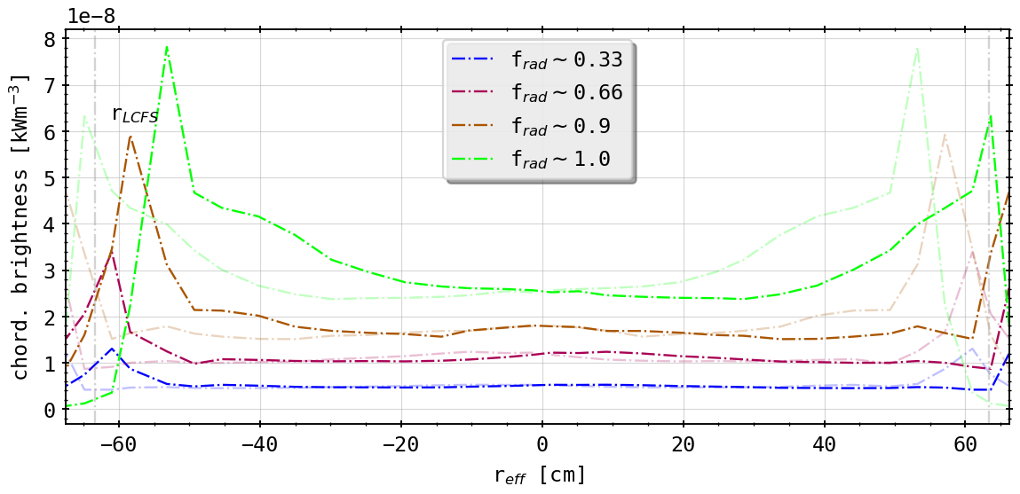
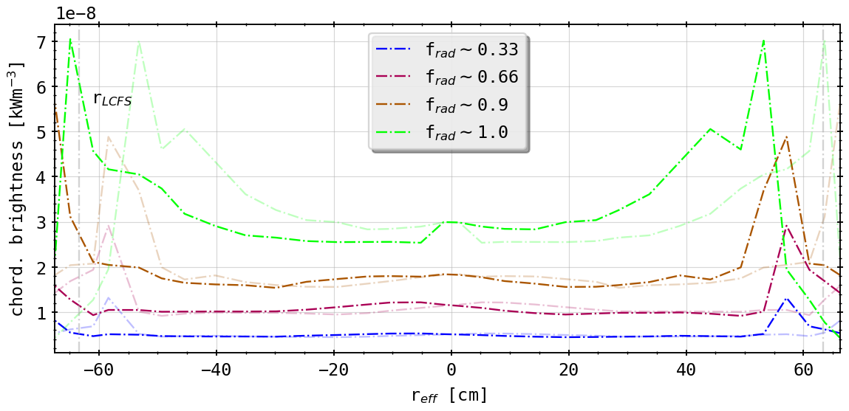
Different Tilts
(2.5° tilt (down))
(-2.5° tilt (up))

Slide 8
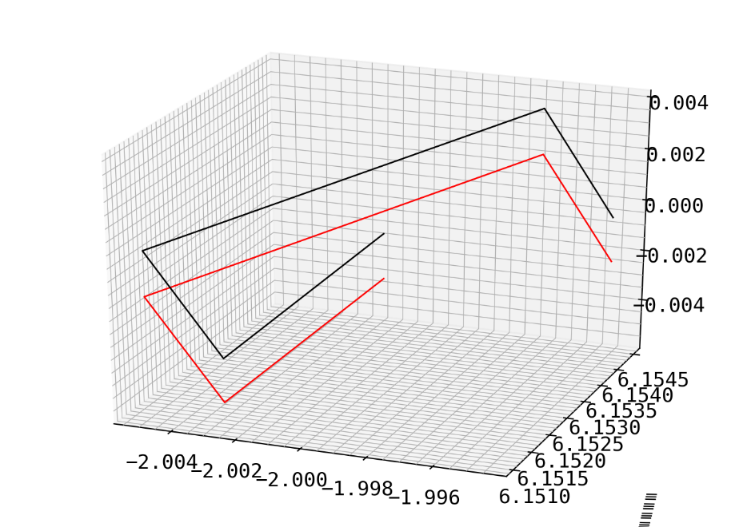
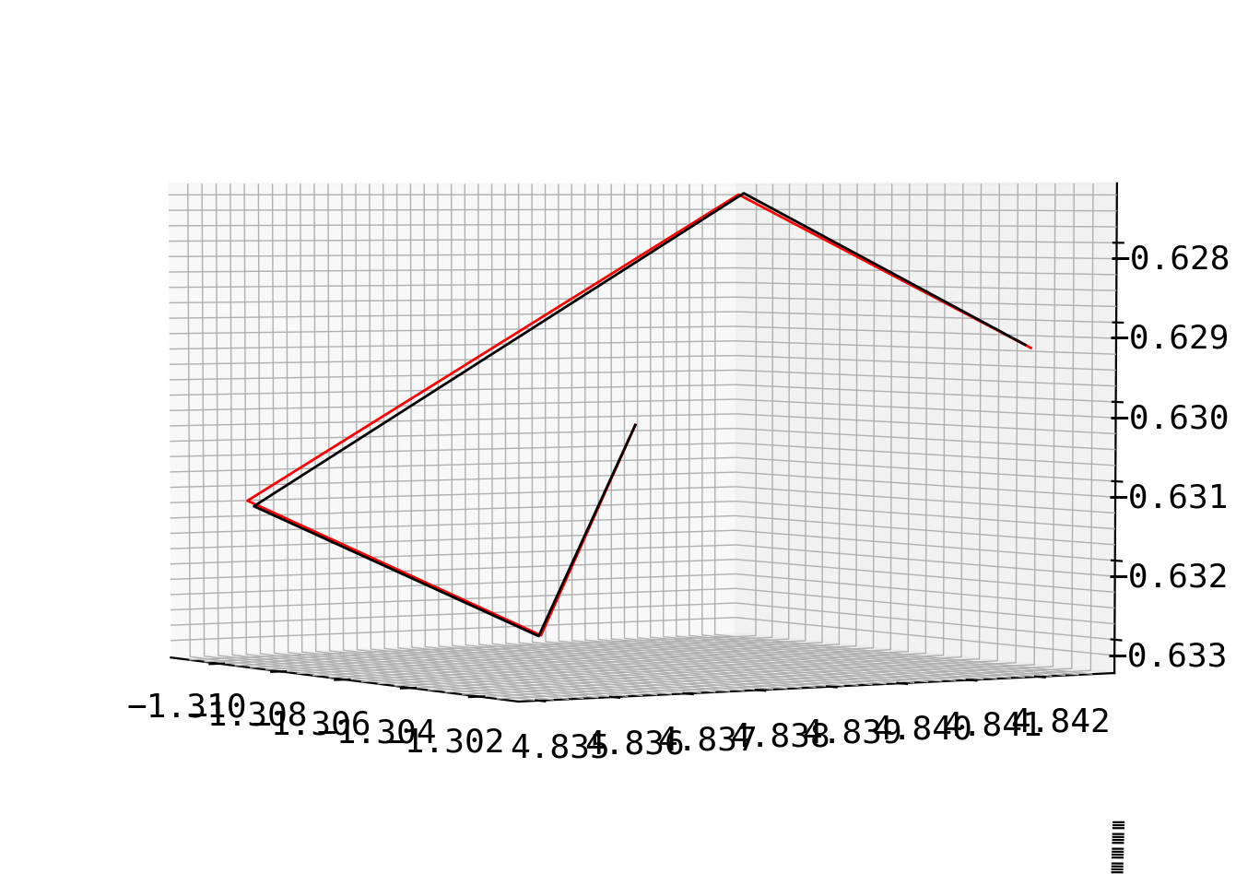
Centering of Aperture and Random Error
center the aperture center (black) on z = 0 axis and shift entire array accordingly to red
introduce measurement error to aperture and detector positions of maximum 0.1mm (randomly distributed) and see resulting tilt in camera fan
degree of tilt 0.5° - 2.0°, but omnidirectional
aperture
centered
perturbed
aperture

Slide 9
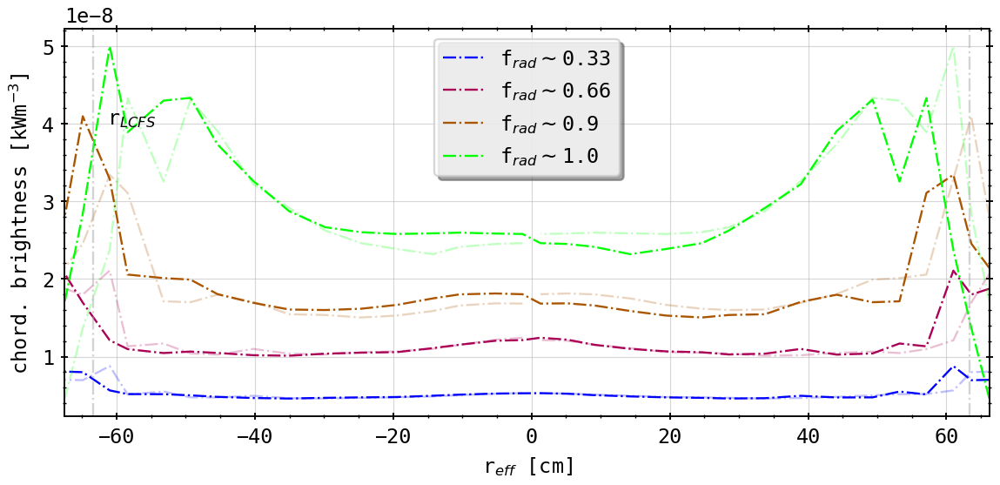
Standard v. Centered Aperture
(standard case)
(centered aperture)
introduction of some more asymmetry close to SOL
possibly resolvable by one of earlier transformations

Slide 10
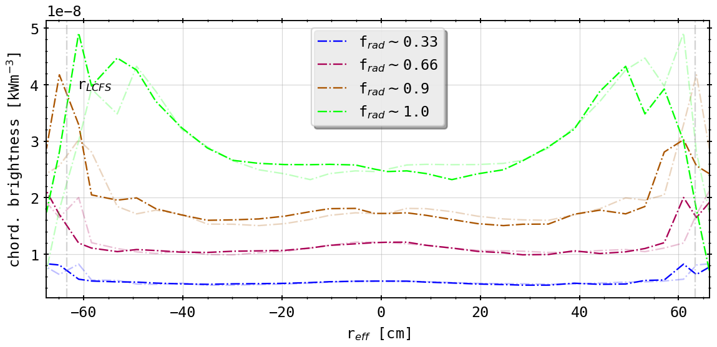
Standard v. Centered Aperture
(centered aperture)
(centered aperture and ‘planar fix’)
still not symmetric, aperture normal and LoS fan tilted still

Slide 11
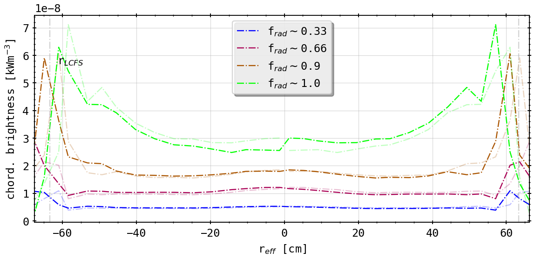
Standard v. Centered Aperture
(centered aperture)
(centered aperture and toroidal transformation)
???

Slide 12
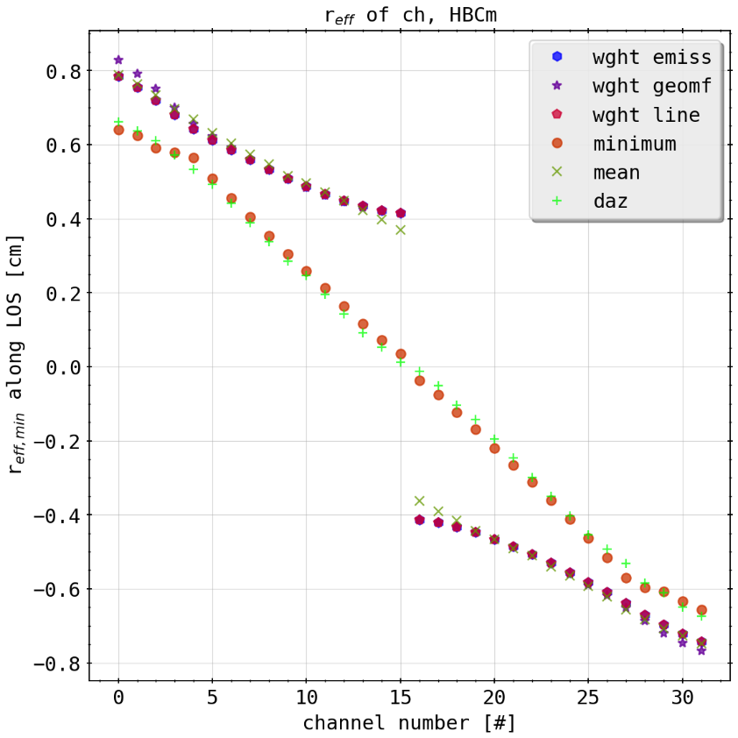
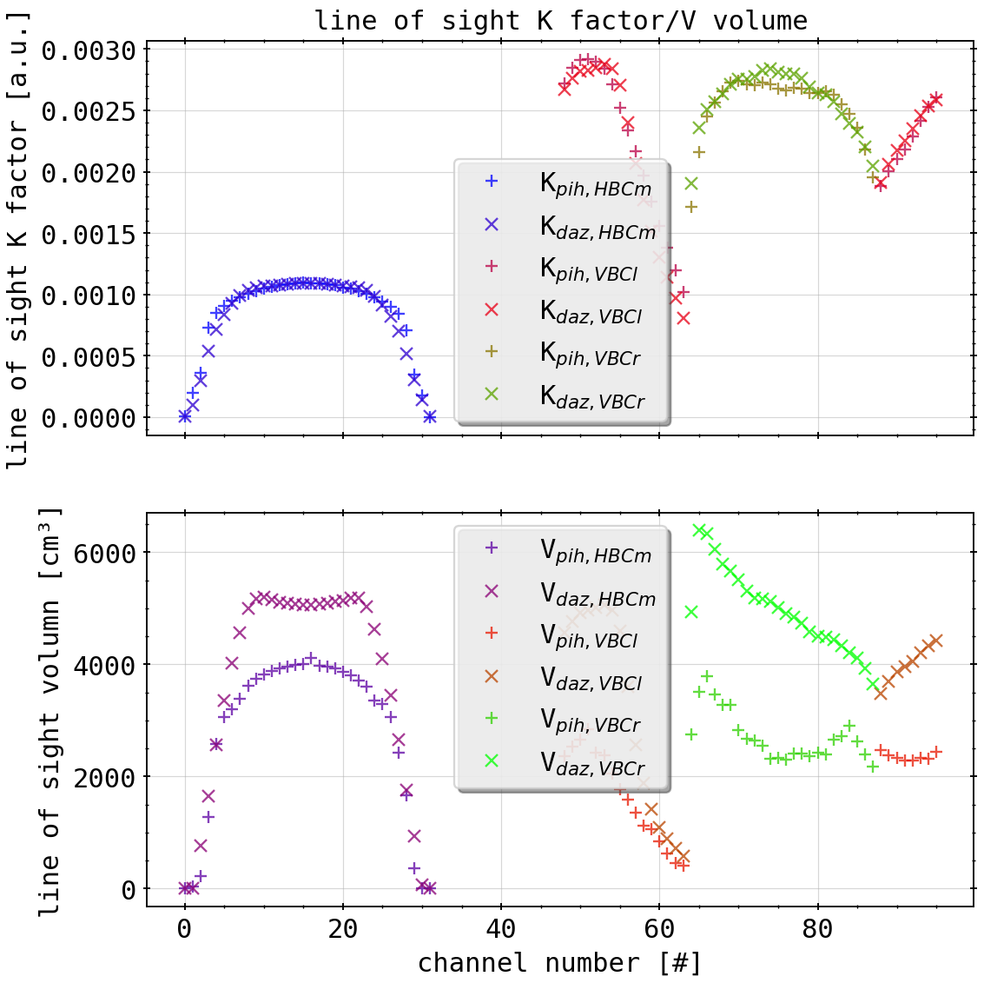
Old Conclusions
intrinsic tilt and toroidal shift indicate the asymmetry from inherently symmetric radiation distribution
possibly flawed inversion if geometry used?
symmetric chordal profiles produced by 0.5° tilt down (from STRAHL)
(effective radii with also different weighting methods)
(K factors and LoS volumes from simple 2D projection)

Slide 13
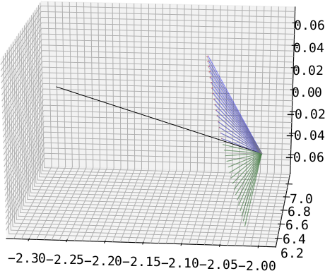
1.: ‘Fix’ Bolometer Planar Error
guided by lower half of detector array (green)
observe difference (red) between opposite channel (e.g. CH#0 <-> CH#31) through rotating around aperture normal by 180° and measuring angle
transforming second channel through rotating it by angle from before (blue)
only really easy for HBCm, because central aperture axis alignment; VBC cameras not possible
aperture
‘fixed’
HBCm
guide

Slide 14
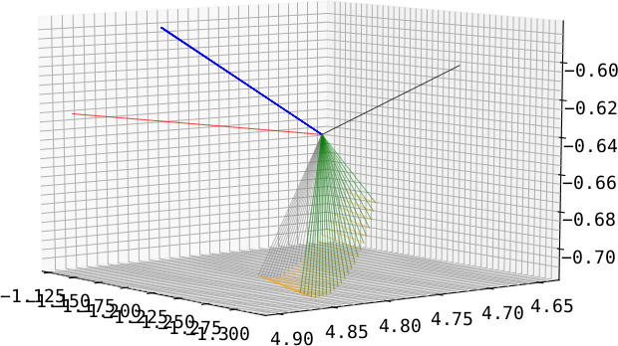
2.: Toroidal Transformation to Axis Plane
guide is normal of plane constructed by detector fan (blue)
transforming all channels so that normal points in/at toroidal direction (red)
transformation for each channel individual (see previous argument (1.)) (orange)
done for all cameras individually
old normal(s)
aperture normal
target normal
old fan
new fan
VBCr

Slide 15
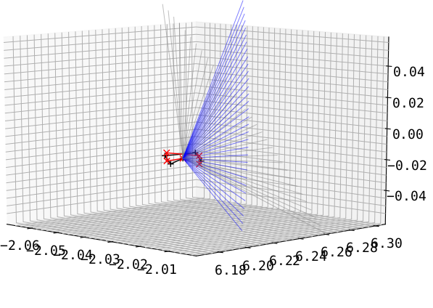
3.: Tilting the Detector Fan Up/Down
take results of (2.) and tilt the entire fan including the aperture poloidally (grey to blue and black to red)
HBCm
(results for (2.) with aperture change included)

